Slide 1
An improved neural network model for treatment effect estimation
Authors: Niki Kiriakidou and Christos Diou
Harokopio University of Athens, Department of Informatics and Telematics
17 – 20 June, 2022

Slide 2
Table of contents
Causal inference
Related work
Proposed approach
Modified Dragonnet
Loss function
Numerical Experiments
Dataset
Evaluation procedure
Conclusion & Future work

Slide 3
Causal inference
Causal inference has been a crucial research topic in many scientific fields
Healthcare
Education
Economics
Primary aim: Answering questions regarding the effect of interventions
Traditional approach
Randomized controlled trials (RCTs)
Challenge
Expensive, time-consuming, ethical restrictions

Slide 4
Problem
Problem
Average Treatment Effect (ATE)
$ψ=E\left[Y|X,T=1\right]−E\left[Y|X,T=0\right]$,
𝜓=𝐸[𝑌|𝑋,𝑇=1]−𝐸[𝑌|𝑋,𝑇=0],
Estimation of treatment effects from observational data.
where:
$X$is a $d−$dimensional space of covariates
𝑋 is a 𝑑−dimensional space of covariates
$T$ is the binary treatment
𝑇 is the binary treatment
$Y$is the outcome for a single sample
𝑌 is the outcome for a single sample

Slide 5
Notations
$Y_{0}$ denotes the outcome for a sample when $T=0.$
$Y_{1}$ denotes the outcome for a sample when $T=1.$
If $T=0$ then:
$Y_{0}$ factual outcome
$Y_{1}$ counterfactual outcome
If $T=1$ then:
$Y_{1}$ factual outcome
$Y_{0}$ counterfactual outcome
In each of the above cases we need to estimate the counterfactual outcome.

Slide 6
Related Work
Research focuses on the predictive power of neural network models for the estimation of treatment effects
Shalit, U., Johansson, F. D., & Sontag, D. (2017). Estimating individual treatment effect: generalization bounds and algorithms. In International Conference on Machine Learning (pp. 3076-3085). PMLR.
Yoon, J., Jordon, J., & Van Der Schaar, M. (2018). GANITE: Estimation of individualized treatment effects using generative adversarial nets. In International Conference on Learning Representations.
Shi, C., Blei, D., & Veitch, V. (2019). Adapting neural networks for the estimation of treatment effects. Advances in neural information processing systems, 32.
TARNet (Treatment Agnostic Representation Network)
GANITE (Generative Adversarial Nets for inference of Individalized Treatment Effects)
Dragonnet

Slide 7
Proposed approach
Modified Dragonnet
Treatment effect estimation through the prediction of the conditional outcomes
Estimation of propensity score
Methodology
Enriching Dragonnet’s inputs with the average outcomes of the nearest neighbors from the control and treatment group along with the covariates.
Loss function – Target regularization (Shi et al.)
Motivation
Reduce bias and increase the prediction accuracy
Exploiting information from the covariates along with information from the outcomes of the instances contained in the training data.

Slide 8
Inputs
${\overline{y}}^{(1)}$ : average of the outcomes of neighbors in treatment group
${\overline{y}}^{(0)}$ : average of the outcomes of neighbors in control group
$X$: vector of covariates
Outputs
$Q\left(1,x\right)=E(Y|1,x)$: conditional outcome for treatment group
$Q\left(0,x\right)=E(Y|0,x)$: conditional outcome for control group
$g\left(x\right)=P(T=1|x)$: propensity score

Slide 10
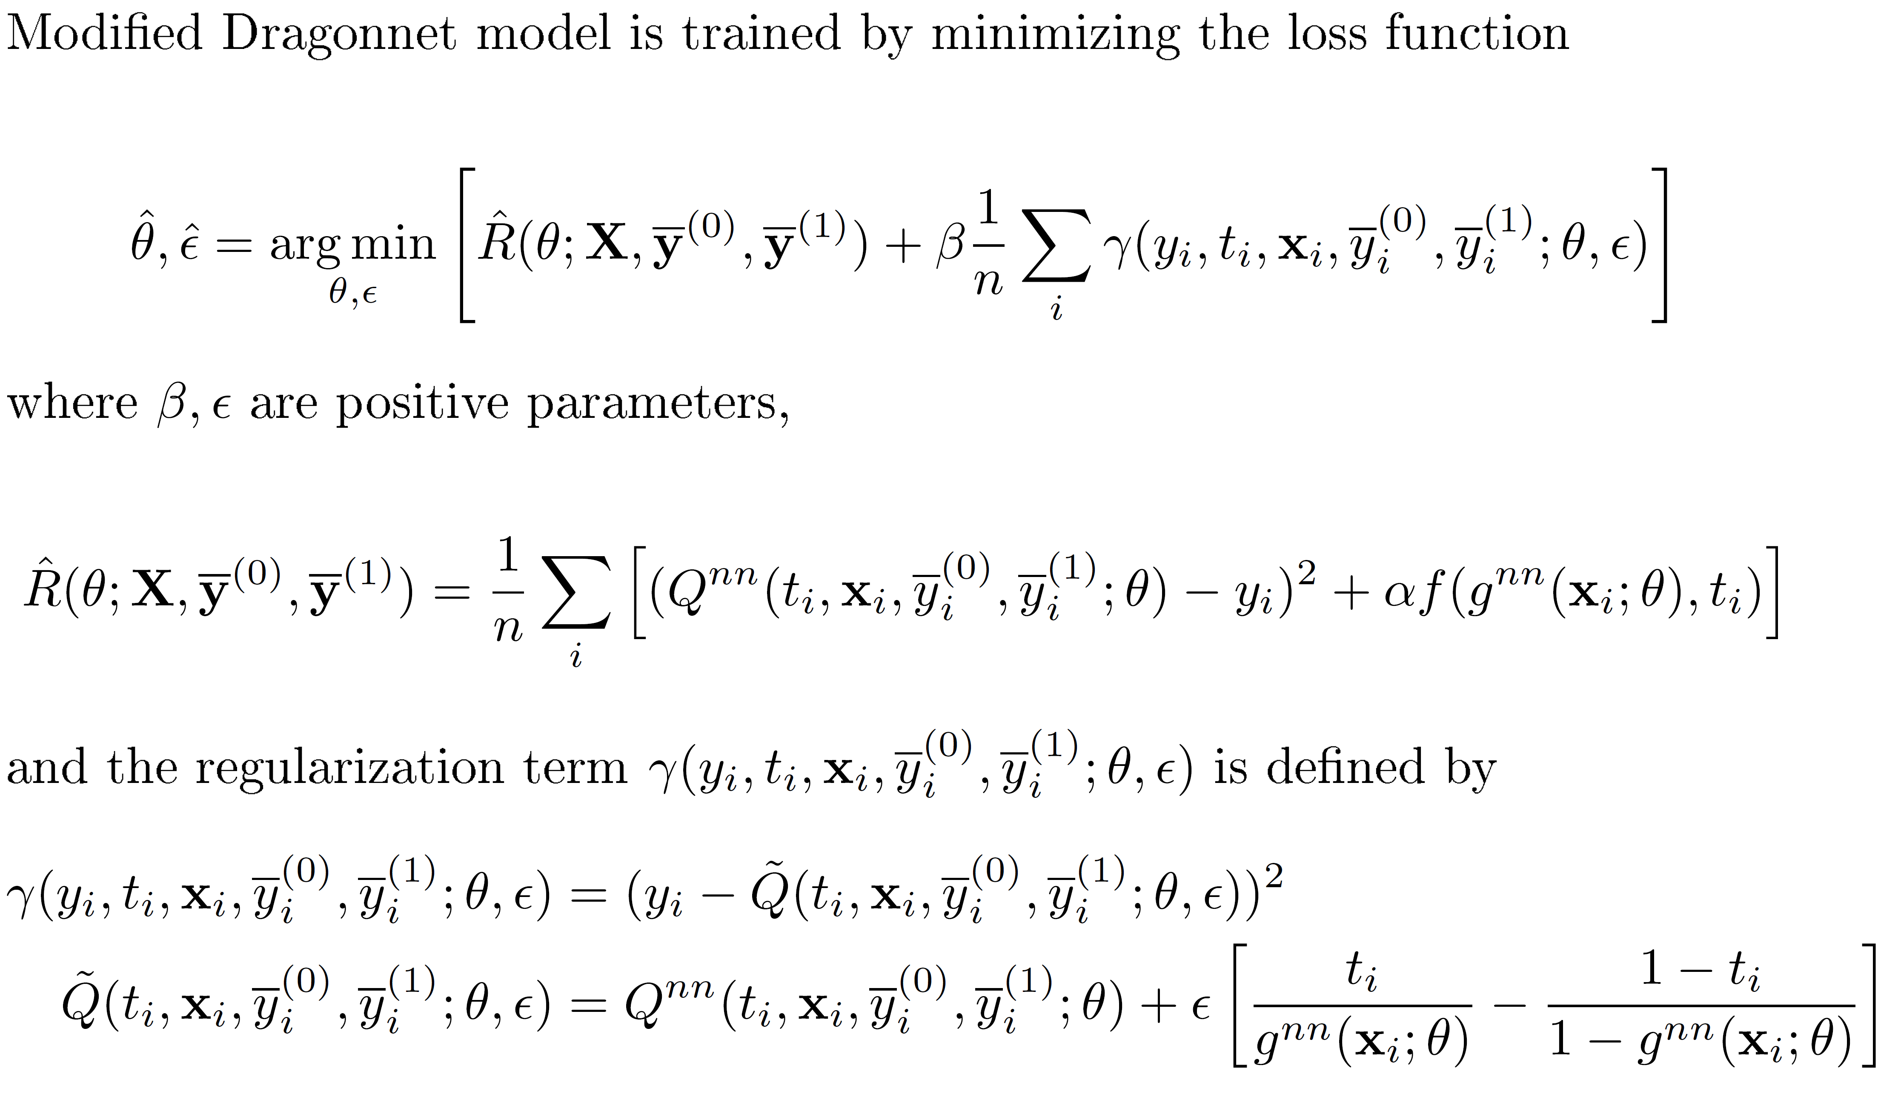
New Loss Function
Based on Targeted regularization (Shi et al. 2019), which induces a bias towards models that have non-parametrically optimal asymptotic properties ‘out-of-the-box’.
Motivation: Increase prediction accuracy

Slide 11
Dataset
Infant Health and Development Program (IHDP)
Semi-synthetic dataset composed by 1000 realizations from NPCI package Dorie, V.: NPCI: Non-parametrics for causal inference, 2016, https://github.com/vdorie/npci
25 features regarding children and mothers
#Instances in treatment group: 139 - #Instances in control group: 608
Goal
Estimation of causal effect of high-quality childcare to remedy problems of low-birth-weight on children’s cognitive test scores

Slide 12
Numerical experiments
Evaluated models
“Dragonnet” (Shi et al. 2019)
“Modified Dragonnet (Euclidean)”
“Modified Dragonnet (Manhattan)”
“Modified Dragonnet (Chebychev)”
Evaluation methodology
Performance profiles of Dolan & More
Statistical analysis

Slide 13
Performance metrics
Absolute error of the estimation of Average Treatment Effect - $|ε_{ATE} |$
Absolute error of the estimation of Average Treatment Effect - |𝜺_𝑨𝑻𝑬 |
Measures treatment effect for the average population
Compare evaluated models as estimators
Precision in Estimation of Heterogeneous Effect - $ε_{PEHE}$
Precision in Estimation of Heterogeneous Effect - 𝜺_𝑷𝑬𝑯𝑬
Measures treatment effect on individual level
Compare evaluated models as predictors

Slide 14
Numerical experiments - $|ε_{ATE} |$
Finding/Conclusions
All compared models reported similar performance
No significant statistical differences in the evaluated models’ performances

Slide 15
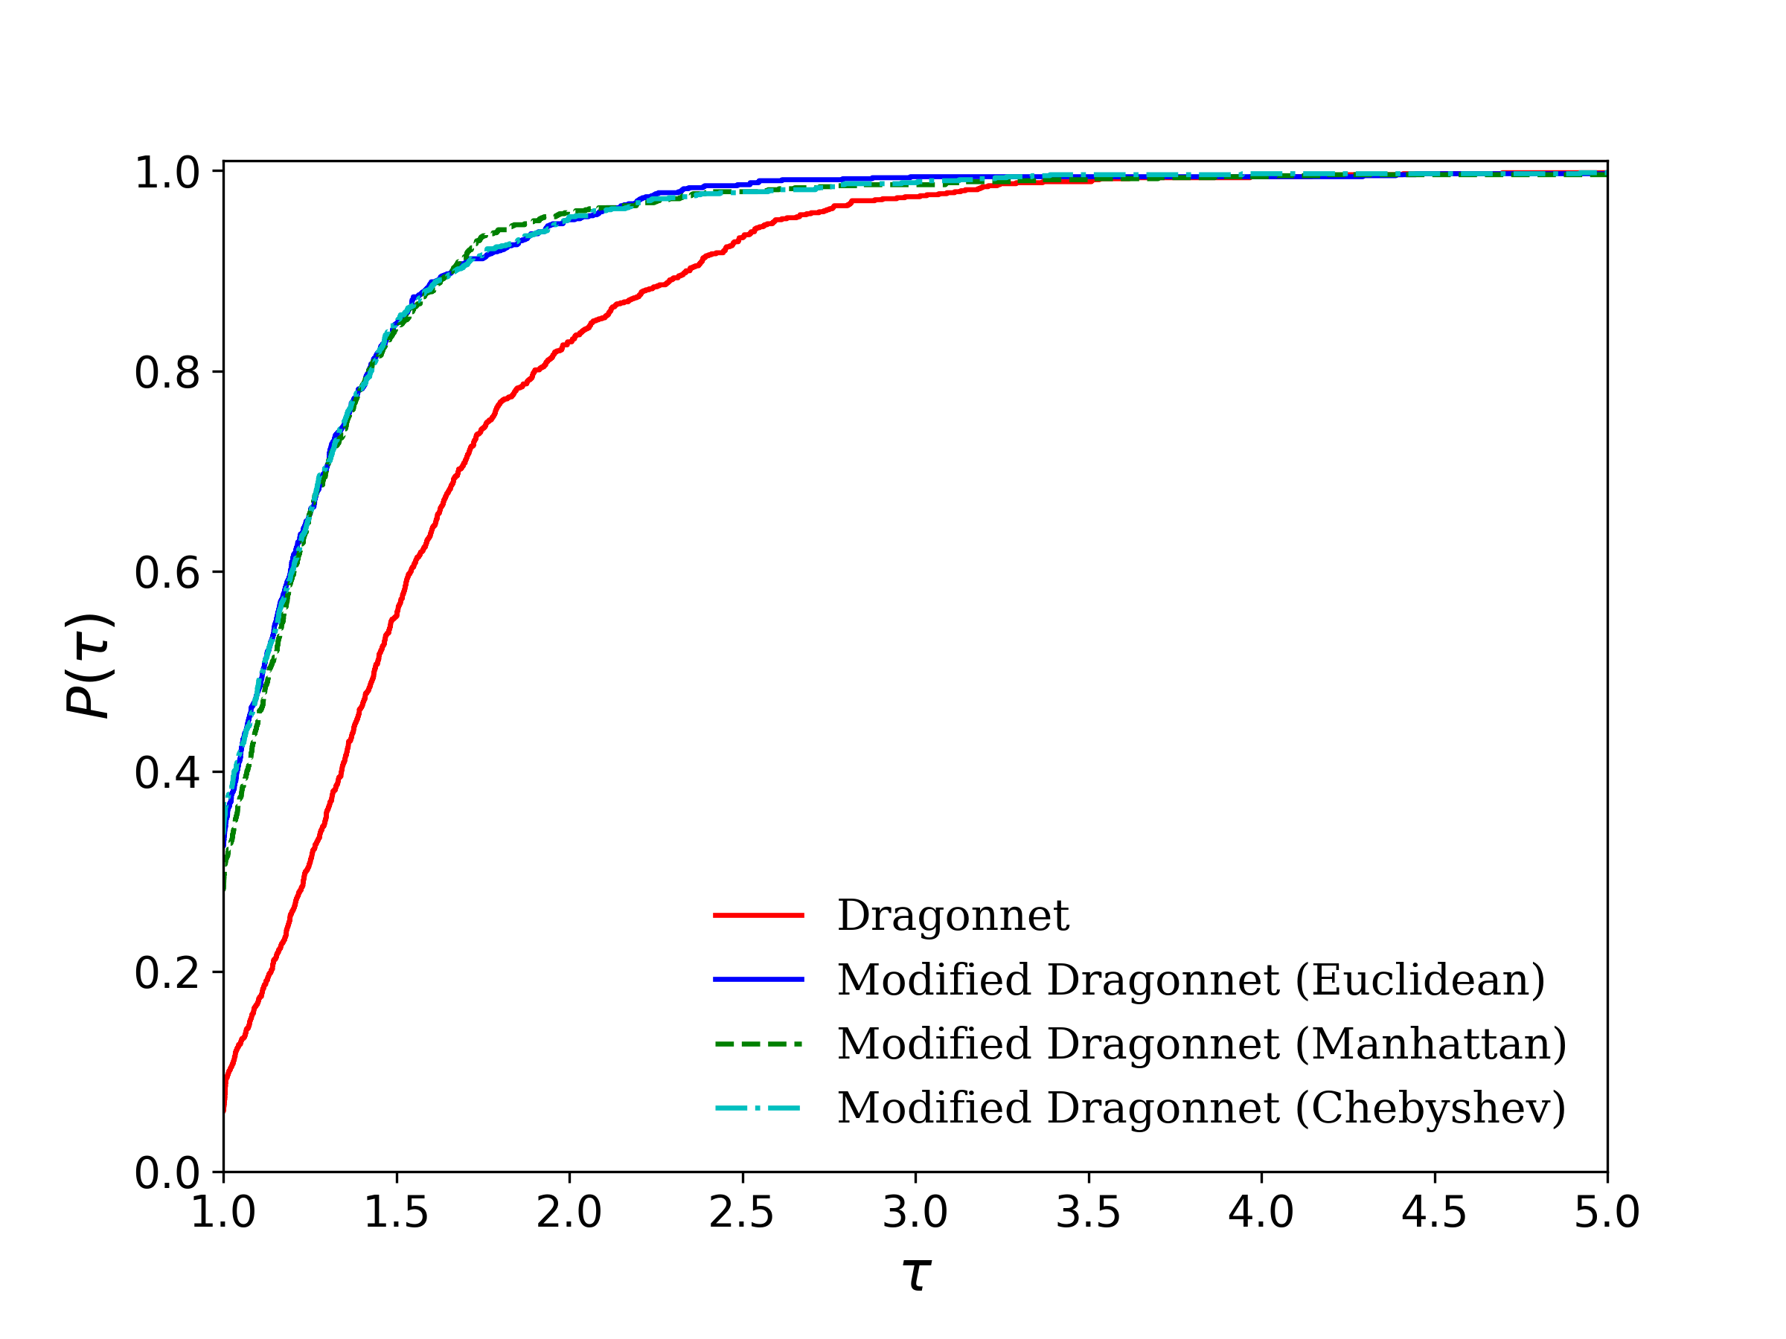
Numerical experiments - $ε_{PEHE}$
Finding/Conclusions
All versions of Modified Dragonnet considerably outperformed Dragonnet
Significant statistical differences in the performance of proposed and SoA model

Slide 16
Numerical experiments
$\left|ε_{ATE}\right|$
$ε_{PEHE}$

Slide 17
Conclusions
Contribution: Modified Dragonnet
Constitutes a modification of SoA causal inference model Dragonnet
Novelty: Exploits information from neighbouring outcomes in the training data.
Experimental Analysis – Conclusions/Findings
Modified Dragonnet performed better than Dragonnet in IHDP.
Provide strong empirical evidence about the efficiency of the proposed approach.
All versions of the proposed Modified Dragonnet performed equally well using three different distance metrics

Slide 18
Future work
Research on optimal value of k-nearest neighbours
Adaptation of distance metrics
Mahalanobis distance
weighted Euclidean distance
Evaluation using more causal inference benchmarks

Slide 19
REBECCA ( Grant Agreement No. (965231 )
(REsearch on BrEast Cancer induced chronic conditions supported by Causal Analysis of multi-source data)

Slide 20
Thank you for your attention
Contact info:
Niki Kiriakidou (kiriakidou@hua.gr) Christos Diou (cdiou@hua.gr)

